Slide 1
ECO-MADE

Slide 2
The main problem is environmental pollution

Slide 3
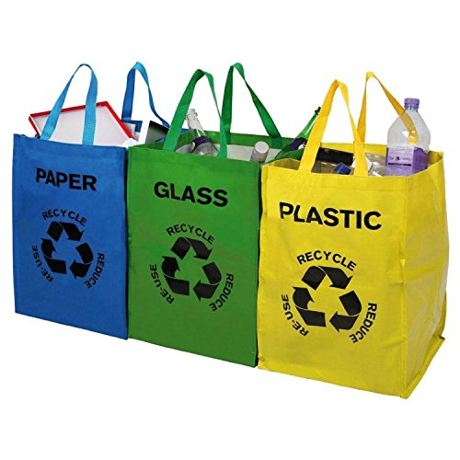
New Product
Garbage
Recycling

Slide 4
Partnerships

Slide 5
Our customers

Slide 6
Expected results
Social side
Business side

Slide 7
Sale channels

Slide 8
Thank you for your attention!

